Slide 1

Final Capstone
Natural Language Processing (NLP) Recommender System for Travel Recommendations
Matthew Kehoe, February 2024

Slide 2
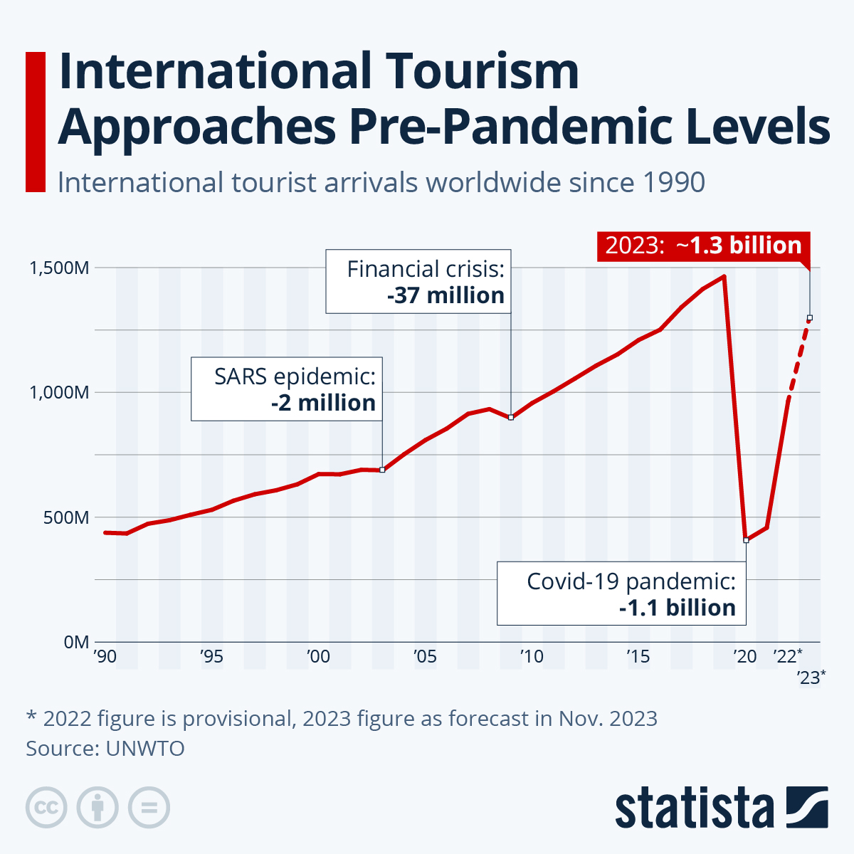
INTRODUCTION
The travel industry was heavily disrupted by the
COVID-19 pandemic.
With the development of vaccines, a lot of people
started to travel again.
In 2023, travel and tourism rebounded back to 2019
levels.

Slide 3
Project Aim and Detail
There are five parts of the project:
Scrape activities from 30 travel destinations in Trip Advisor.
Perform data analysis and modeling.
Make an NLP recommender system to predict future travel destinations.
Create a Dash app to make personalized travel recommendations.
Analyze limitations and discuss future enhancements.

Slide 4
Part 1 – Web Scraping

Slide 5
Data Gathered
• Used Beautiful Soup to scrape 56,109 activities from 30 destinations in Trip Advisor.
• 52,745 of the 56,109 activities are unique.
• I scraped up to 3,000 activities at the 30 travel destinations.

Slide 6
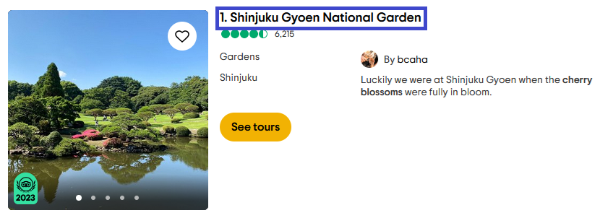
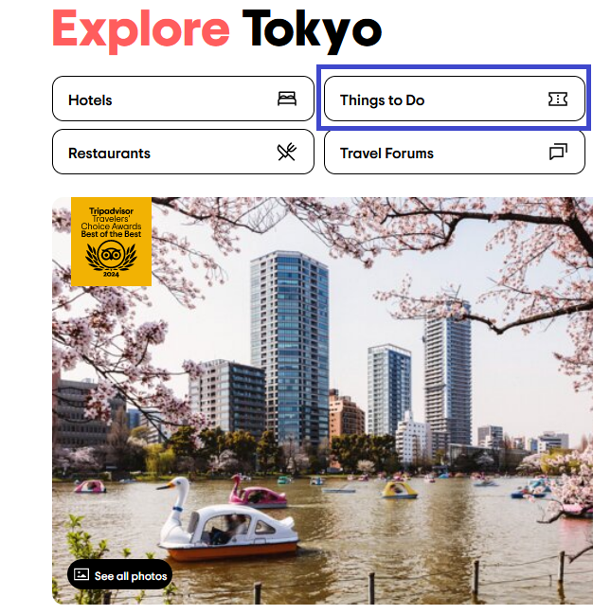

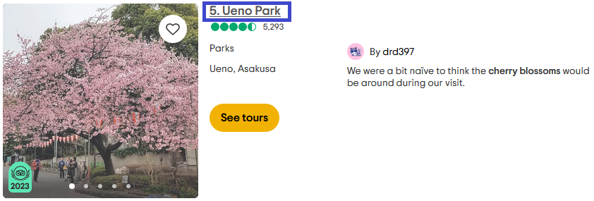
Tokyo, Japan

Slide 7
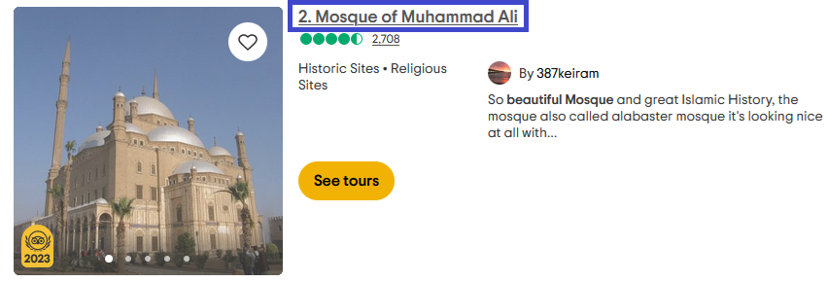
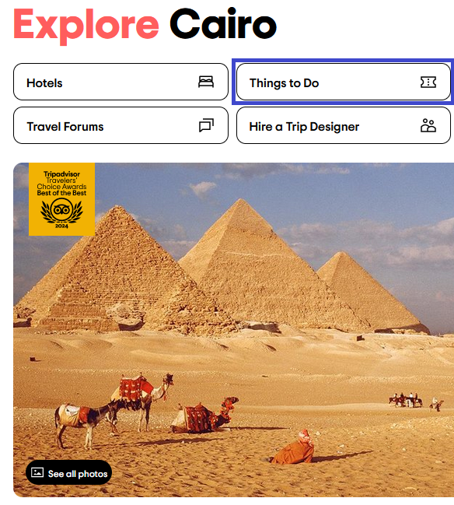
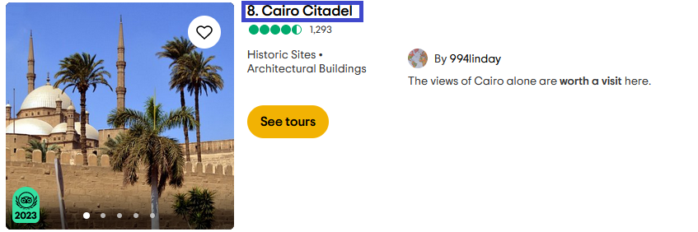
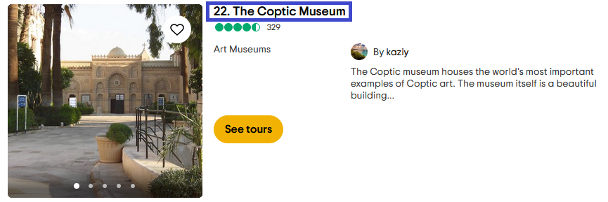
Cairo, Egypt

Slide 8
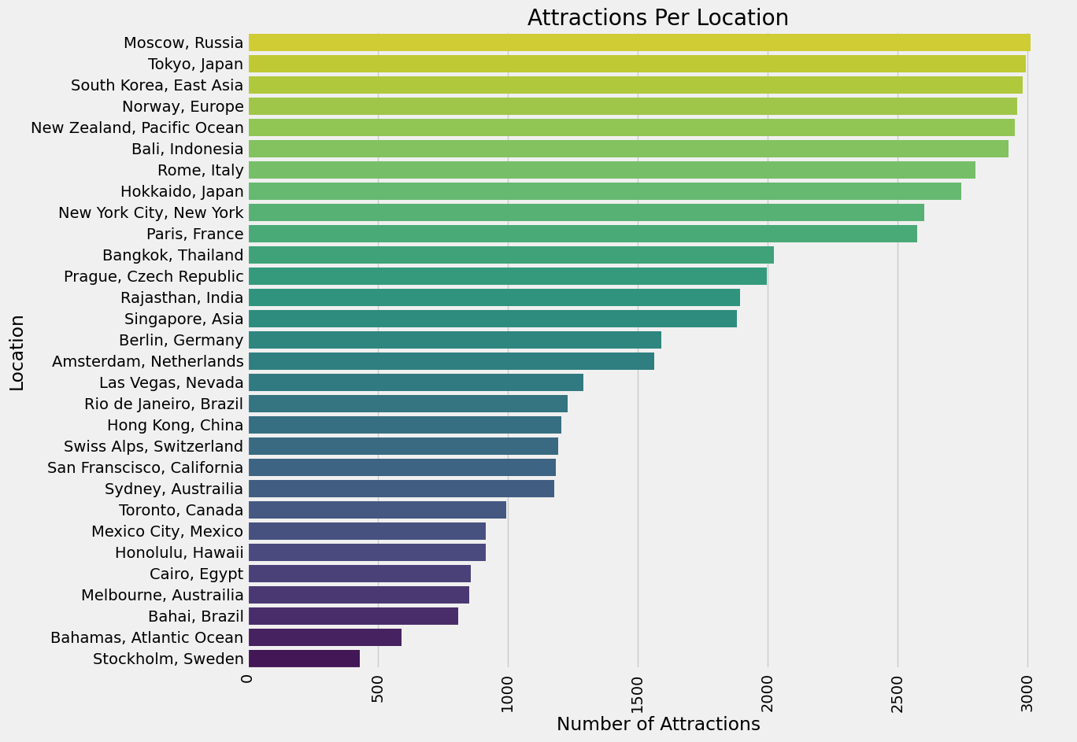
Data

Slide 9
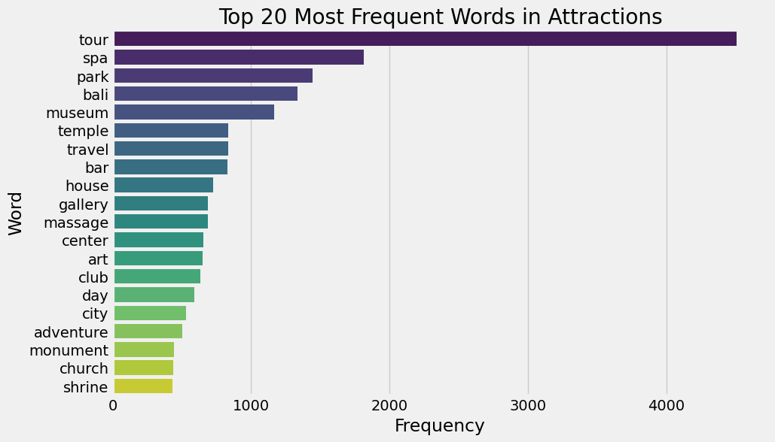
Most Frequent Words

Slide 10
Part 2 – Data Analysis and Modeling

Slide 11
Data Cleaning

Slide 12
Word Cloud

Slide 13
Model Setup
• To prepare the NLP system, I split the 52,745 activities into Train and Test.
• Train had 39,873 activities and Test had 13,291 activities.
• I corrected for class imbalance through adding weights.
• I had 30 classes so needed to perform Multi-Class Classification.

Slide 14
Establishing a Baseline
• As a first pass, I used a Naïve Bayes estimator as a baseline for text classification.
• This gave me a training accuracy of 77.9% and a test accuracy of 48.0%.
• Concerned that my model was overfitting, I switched to the Complement Bayes Estimator and implemented:
TD-IDF Vectorization
Count Vectorization
Unigrams and Bigrams

Slide 15
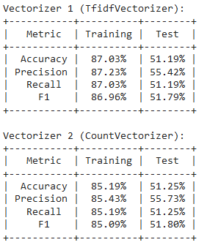
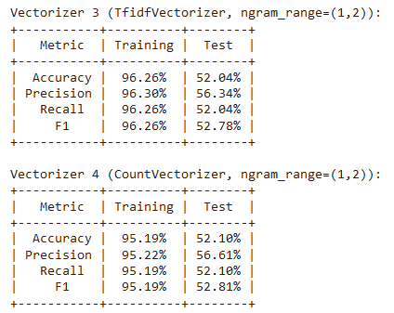
Model Comparison

Slide 16
Part 3 – NLP Recommender System

Slide 17
Preliminary Recommender System
• I then used cosine similarity to create two recommender systems using TD-IDF Vectorization and Count Vectorization.
• As before, TD-IDF Vectorization had slightly better metrics that Count Vectorization.

Slide 18
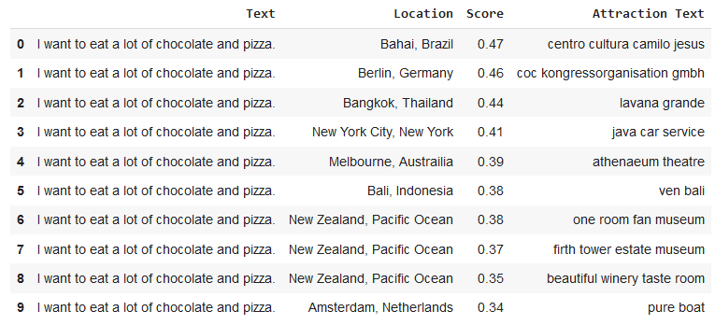
TD-IDF Vectorization Results

Slide 19
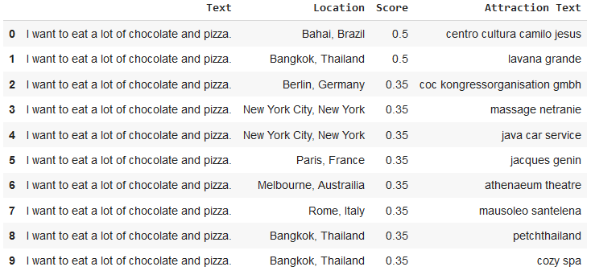
Count Vectorization Results

Slide 20
Model Selection
Multiple target variables with numerous features sounds like a great case for classification.
K-Nearest Neighbors is my first choice.
This is a classification problem, so I will also try Logistic Regression.
Support Vector Machine is also a good choice.
I will also implement a Decision Tree classifier.
I will also try a variety of ensemble methods: Bagging Decision Tree, Boosting Decision Tree, Random Forest and Voting Classifier.

Slide 21
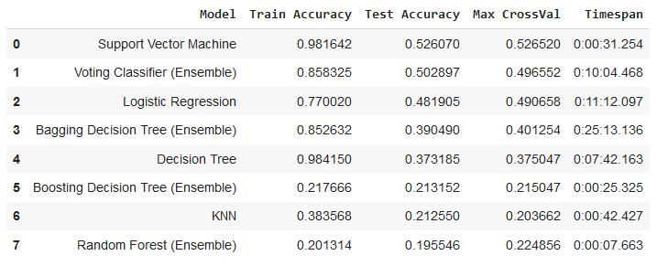
Model Results

Slide 22
Model Performance
Best performers, ranked:
Support vector Machine
Voting Classifier (Ensemble)
Logistic Regression
Bagging Decision Tree (Ensemble)
Decision Tree
Boosting Decision Tree (Ensemble)
KNN
Random Forest (Ensemble)

Slide 23
Model Speed
Fastest performers, ranked:
Random Forest (Ensemble)
Boosting Decision Tree (Ensemble)
Support Vector Machine
KNN
Decision Tree
Voting Classifier (Ensemble)
Logistic Regression
Bagging Decision Tree (Ensemble)

Slide 24
BERT

Slide 25
Part 4 – Dash App

Slide 26
Part 5 – Conclusion and Enchancements

Slide 27
CONCLUSION
• The images for the COVID-19 chest xrays were classified and evaluated with test data to get 92% test accuracy.
• The positive cases of New York are continuing to increase at least for the next 30 days.
• The positive cases for Illinois are increasing on a higher rate, all the other states are expected a mild increase for the next 10 days.
• Washington State has the highest recovery rate as of May 12.

Slide 28
THANK YOU!

